Slide 1
Data Mining
Mohammad Usman Khan

Slide 2
Business Problem
Identify the clusters, made in the online tweets
In order to understand people’s opinions about #MeToo
Sentiment analysis of the tweets

Slide 3
Data Understanding
The data was extracted from twitter
Using the twitter scraper
The tweets extracted were in different languages

Slide 4
Data Preparation

Slide 5
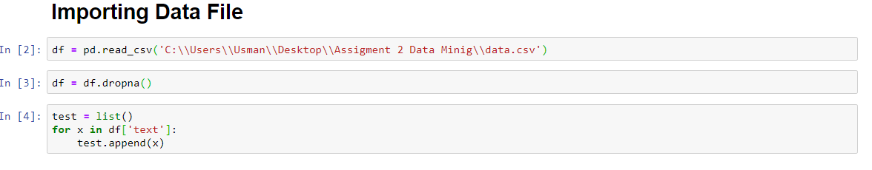

Slide 6
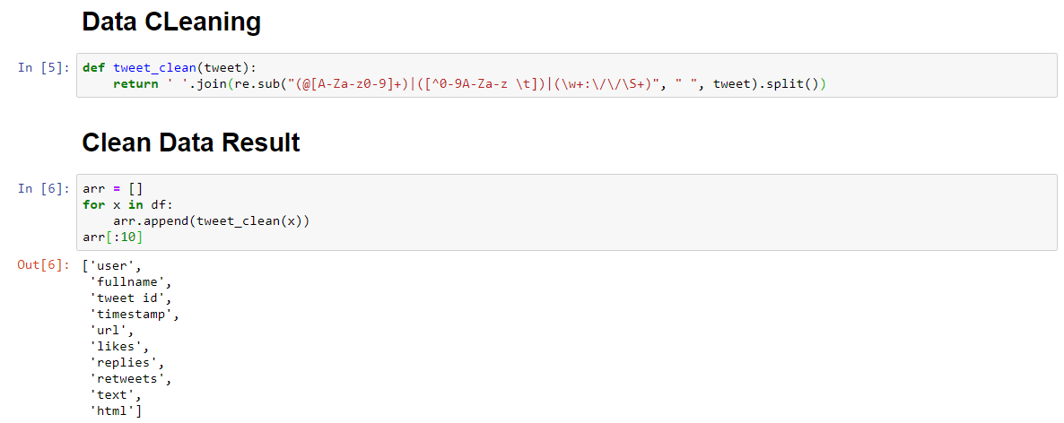

Slide 7
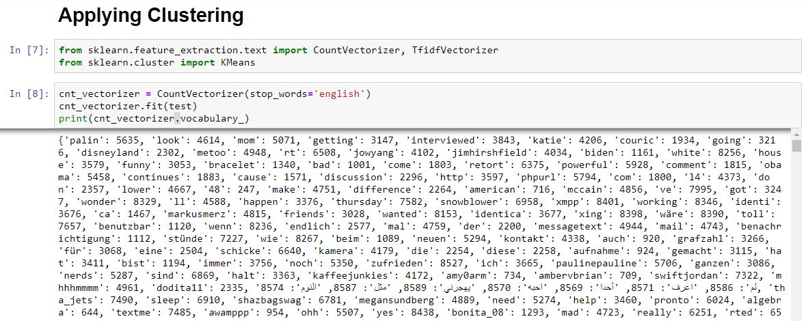

Slide 8
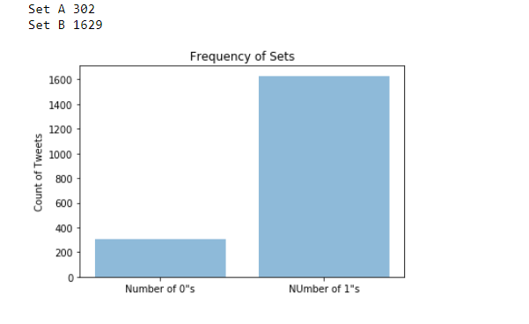
Results

Slide 9
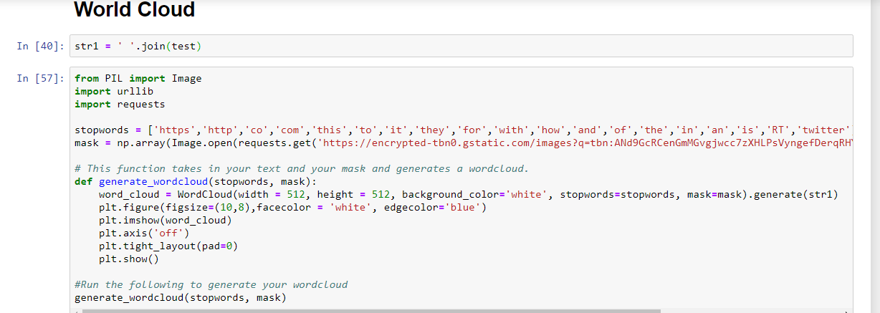
Word Cloud

Slide 10
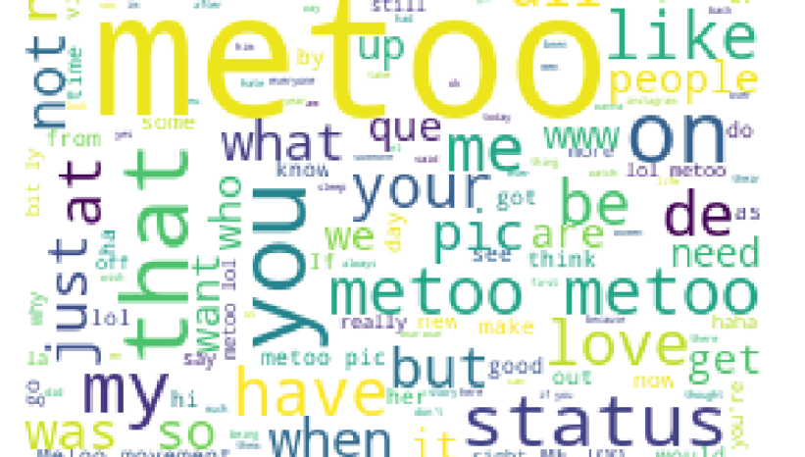
Visualisation

Slide 11
Data Modeling

Slide 12
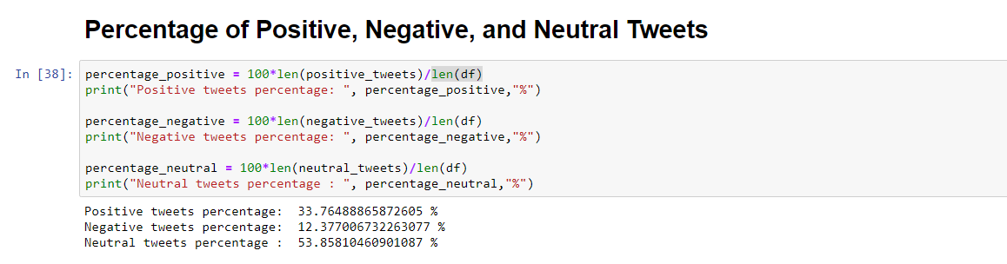
Textblob

Slide 13
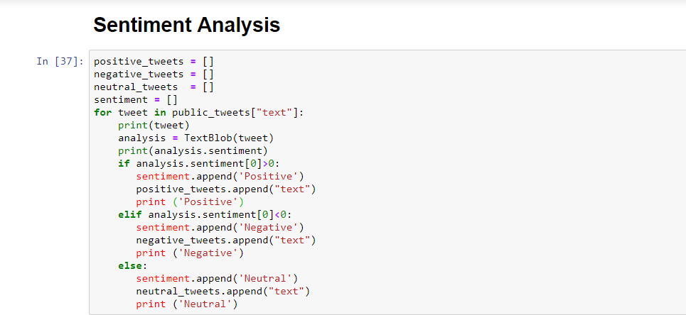
Sentiment Analysis

Slide 14
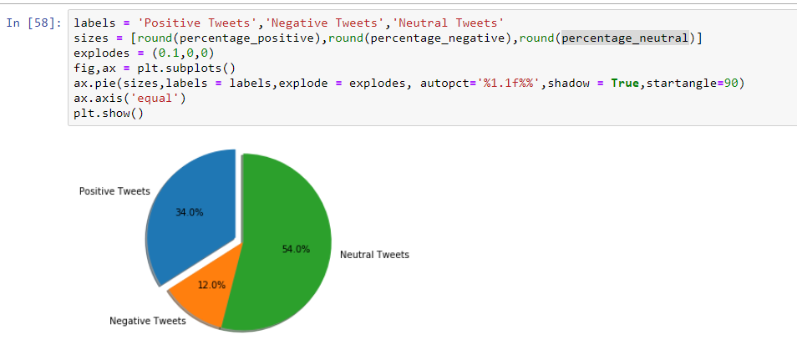
Percentages of Tweets

Slide 15
Conclusion
The result of the last slides clearly show that most of the tweets and neutral as people usually narrates the incident
Secondly we come to the conclusion that round 35% people encourage the #meToo movement in comparison to only 12% against it

